Slide 1
Texas Tech University – Space Raiders
USLI Preliminary Design Review 2019 – 2020
Texas Tech Mechanical Engineering Department:
2500 Broadway St, Lubbock, TX 79409
raider.aerospace@gmail.com

Slide 2
Rocket Design Overview
Static Stability Margin: 2.12
CG: 51.181 in.
CP: 64.173 in.
Outer Diameter: 6.142 in.
Total Length: 102.756 in.
Weight: 50.393 lbs.

Slide 3
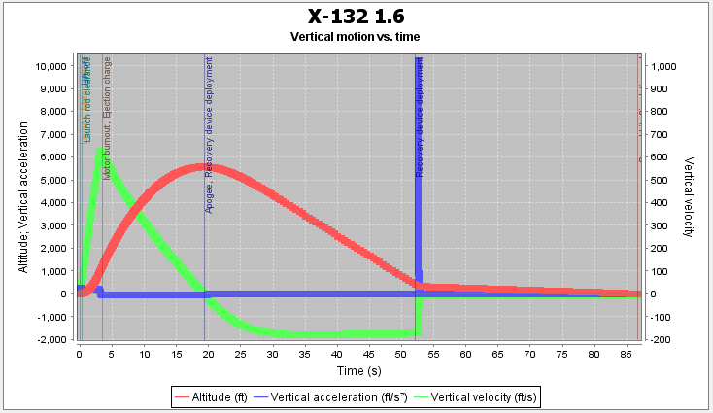
Mission Overview
The goal of the launch is to reach our target apogee and recover the rocket while deploying the payload on ground level to collect a sample of ice.
Thrust to Weight Ratio | Velocity off Rod | Apogee | Velocity at Deployment | Optimum Delay | Max Velocity | Max Acceleration | Time to Apogee | Flight Time | Ground Hit Velocity
7.80 | 62.5 ft/s | 5222 ft | 179 ft/s | 15.2 s | 594 ft/s | 220 ft/s^2 | 18.6 s | 80.8 s | 10.6 ft/s

Slide 4
Vehicle Team

Slide 5
Nose Cone
Materials: Polycarbonate and Fiberglass composite
Polycarbonate tip with length of 8.75 in. contains the 360º camera
Fiberglass portion contains the payload
Shape: Ogive
Length: 24.016 in.
Base Diameter: 6.142 in.

Slide 6
Airframe – Fore Section
Design: Contains the drogue chute
Materials: Carbon Fiber
Length: 19.00 in.
Inner Diameter: 6.007 in.
Thickness: 0.056 in.

Slide 7
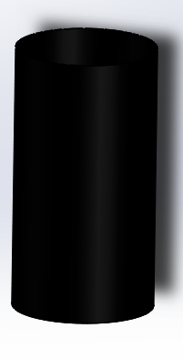
Airframe – Ebay Section
Design: Contains the electronics bay
Materials: Carbon Fiber
Length: 11.50 in.
Inner Diameter: 6.007 in.
Thickness: 0.056 in.

Slide 8
Airframe – Aft Section
Design: Contains all the motor components
Materials: Carbon Fiber
Length: 48.00 in.
Inner Diameter: 6.007 in.
Thickness: 0.056 in.

Slide 9
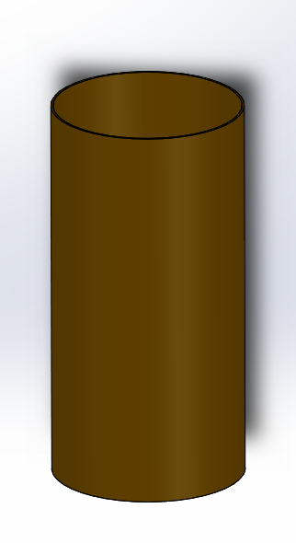
Couplers
Design: Total of 2 couplers that connect the ebay to the aft/for sections
Materials: Phenolic
Length: 12.00 in.
Outer Diameter: 6.007 in.
Inner Diameter: 5.859 in.
Weight: 0.32 lbs. (each)

Slide 10
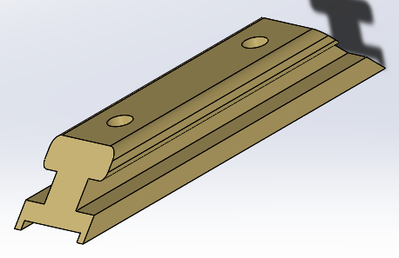
Launch Lugs
Design: Total of 2 linear launch rail buttons, place at CG and CP of the rocket
Materials: Urethane Plastic
Length: 3.00 in.
Width: 0.65 in.
Mass: 0.02 lbs. (each)

Slide 11
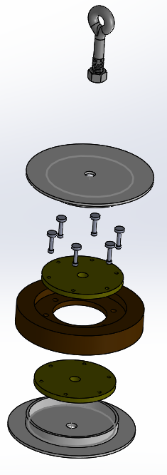
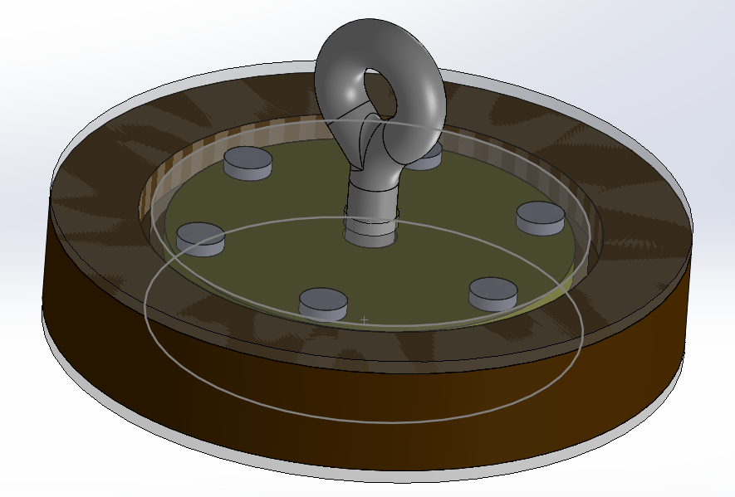
Bulkheads
Design: Function as shock absorbers, total of 4 bulkheads
Materials: Marine grade plywood, nylon, and fiberglass
Outer Diameter: 5.865 in. (ebay section bulkheads)
Outer Diameter: 6.007 in. (aft/fore section bulkheads)
Thickness: 1.252 in.

Slide 12
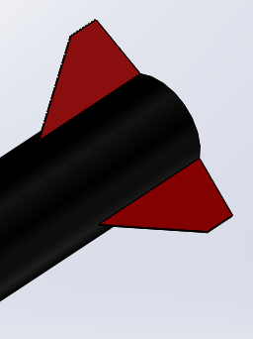
Fins
Design: Total of 3 fins designed with a composite material
Materials: Carbon fiber and fiberglass sheets
Shape: Trapezoidal
Height: 4.00 in.
Thickness: 0.0626 in.

Slide 13
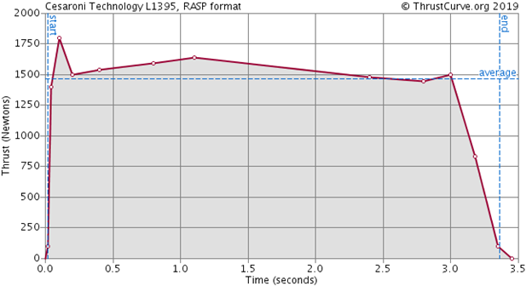
Motor
Cesaroni L-1395 BS:
Diameter | 2.95 in.
Length | 24.45 in.
Weight | 9.52 lbs
Max Thrust | 400.48 lbs
Burn Time | 3.51 sec.
Yield Apogee | 5854 ft

Slide 14
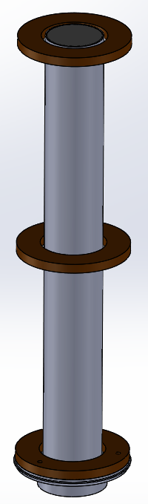
Motor Components
Cesaroni Pro 75 4G Motor Casing:
Length: 23.95 in.
Outer Diameter: 2.966 in.
6061-T6 Motor Retention:
Mass: 139 grams

Slide 15
Centering Rings
Design: Total of 3 rings used to stabilize the motor casing
Material: Maple hardwood
Outer Diameter: 6.00 in.
Inner Diameter: 3.10 in.
Thickness: 0.50 in.
Weight: 1.13 lbs.

Slide 16
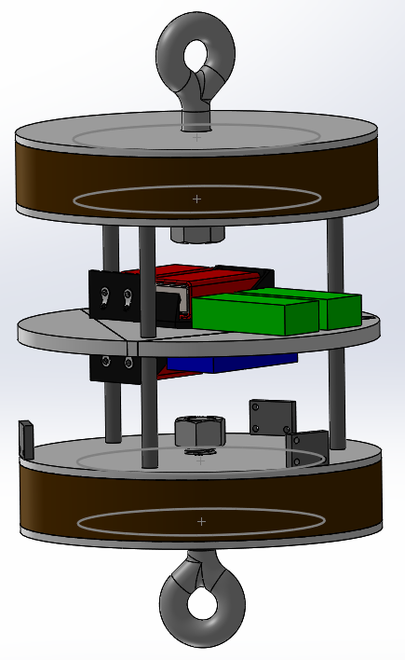
Electronics Bay
Design: Contains our GPS trackers, altimeters, 9V battery, and is placed in between 2 bulkheads secured with 3 rods
Circular Plate OD: 2.90 in.
Rod OD: 0.25 in.
Rod Length: 4.00 in.
Total Mass: 4.00 lbs.

Slide 17
Payload Team

Slide 18
Retention Method
Details: Double Bulkhead Design with interior Locking mechanism.
YEEEEEEEEEEEEEEEEEEEEEEEEEEEEEEEEEEEEEEEEEEEEEEEEEEEEEEEEEEEEEEEEEEEEEEEEEEEEEEEEEEEEEEEEEEEEEEEEEEEEEEEEEEEEEEEEEEEEEEEEEEEEEEEEEEEEEET
YEEEEEEEET

Slide 19
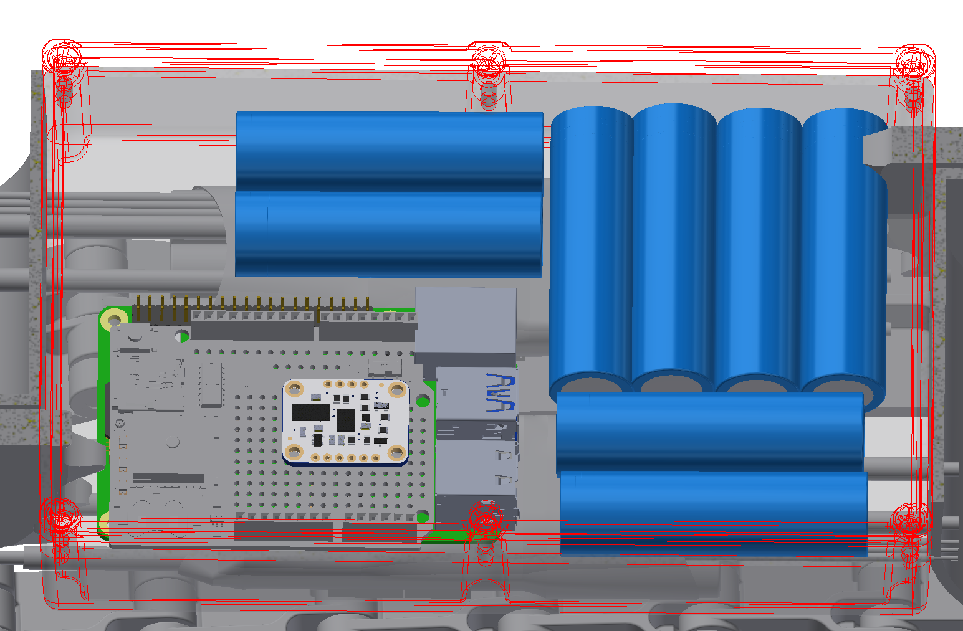
Electronic Box
Design: battery, battery charger, voltage regulator, motor controller, micro controller, 9-dof sensor gps unit

Slide 20
Power Section
Power Systems are separated into two distinct systems.
energy storage is a collection of 18650s
Overcurrent
Notes:
separate step ups, seperate battery cells, fly back diode, Chassis Grounding plane

Slide 21
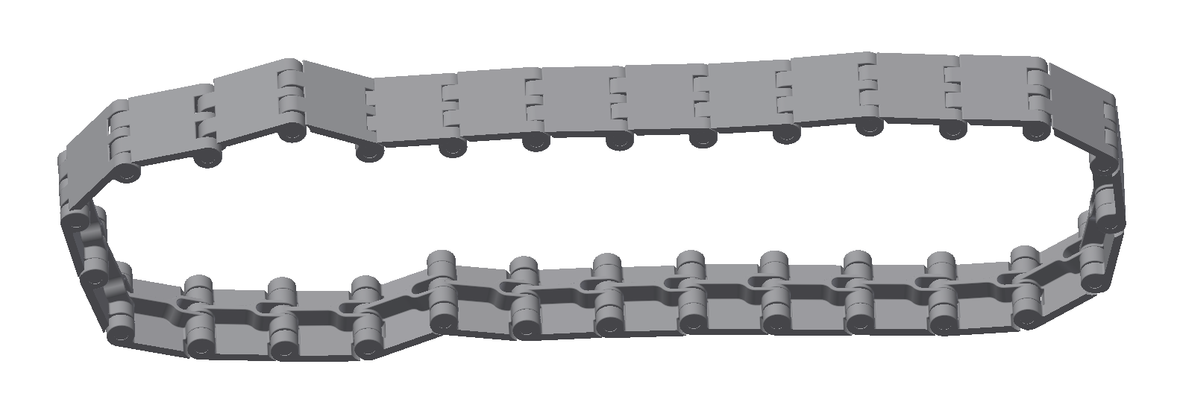
Movement
Details: Tank Tread based, Two Motors.

Slide 22
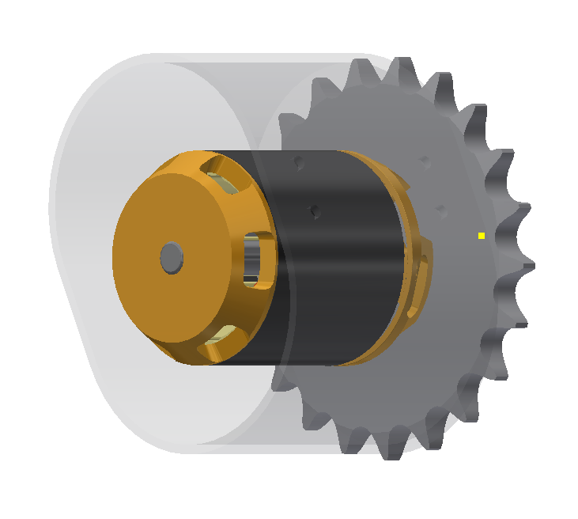
Motor Components
Details:Motor Housing, Motor Controller.

Slide 23
Collection Method
Details- low incline ramp located between the treads.
Ice sample retained inside motor mounting chassis.

Slide 24
Recovery Team

Slide 25
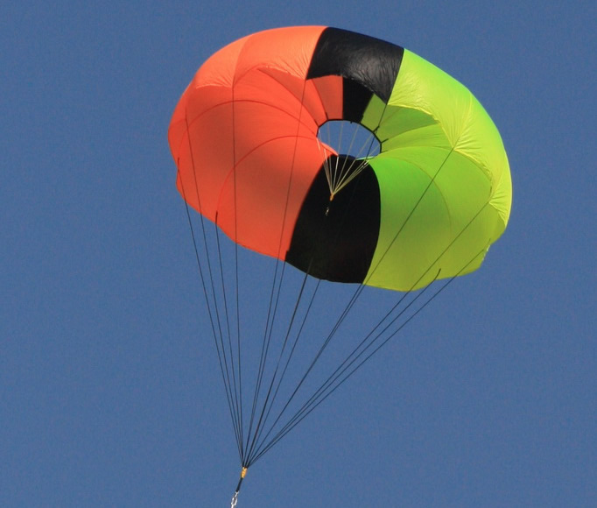
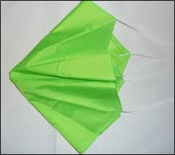
Parachutes
Main
Drogue
Diameter: 14 ft.
Drag Coefficient: 2.2
Material: Ripstop Nylon
Manufacturer: Fruity Chutes
Diameter: 1.5 ft.
Drag Coefficient: 0.7
Material: Ripstop Nylon
Manufacturer: Top Flight Recovery

Slide 26
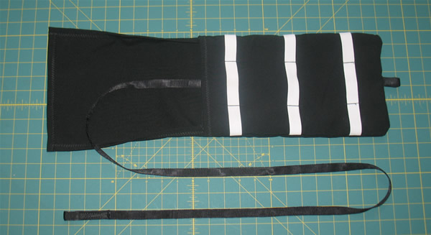
Packing Method
Deployment Bag:
High packing density
Reliable deployment
Chance of entanglement reduced
Parachute protection

Slide 27
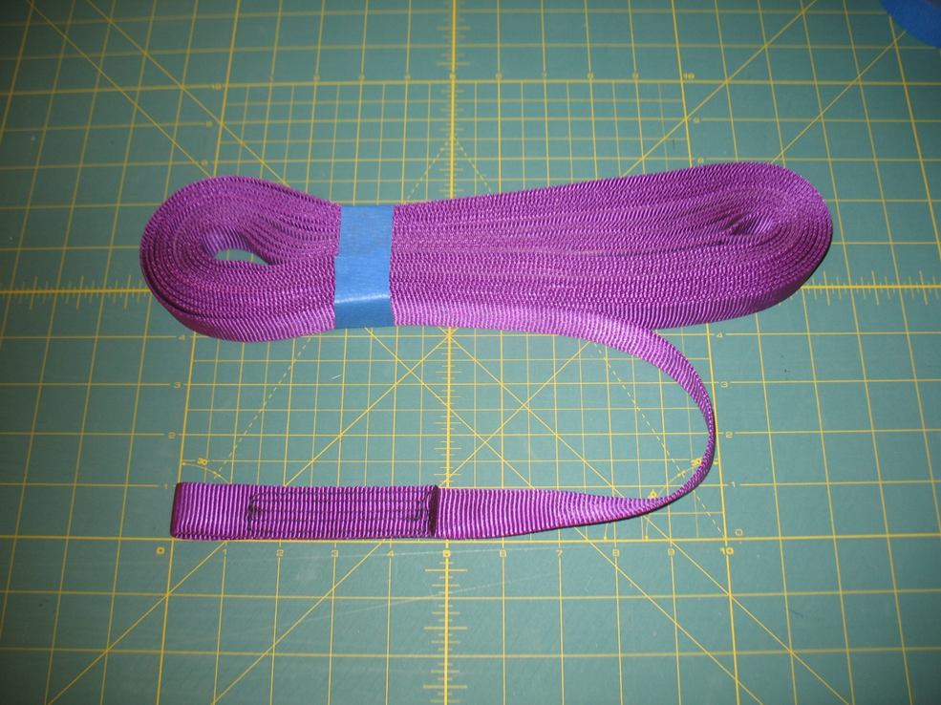
Shock Cords
Material: 1’’ tubular Nylon webbing
Soft material
Energy absorption
Less likely to cause zippering
Doubled-up shock cords
Manufacturer: Fruity Chutes

Slide 28
Ejection Charges

Slide 29
Safety Team

Slide 30
General Safety
Intensive Documentation
Checklists
MSDS Sheets and Safety Assessments
Final Sign Off Sheets
Enforce Safety Requirements
Review all procedures and checklists
Monitor all activities
Personal Protective Equipment

Slide 31
Mission Performance Predictions

Slide 32
Kinetic Energy
Landing Velocity:
Landing Kinetic Energy:

Slide 33
Descent Times
Apogee to Main Deployment:
Main Deployment to Landing:
Total descent time: 78.40 s

Slide 34
Drift
WindSpeed (mph) | Drift (ft.)
0 | 0.0
5 | 600.7
10 | 121.4
15 | 1802.2
20 | 2402.9

Slide 35
Flight Simulation
Velocity off Rod | 62.5 ft/s
Apogee | 5222 ft
Deployment Velocity | 179 ft/s
Optimum Delay | 15.2 s
Max. Velocity | 594 ft/s
Max. Acceleration | 220 ft/s^2
Time to Apogee | 18.6 s
Flight Time | 80.8 s
Landing Velocity | 10.6 ft/s

